Slide 1

ANALYSIS AND EXPERIMENTAL INVESTIAGTION OF CATALYTIC CONVERTER WITH CERAMIC COATING BY PLASMA SPRAY COATING
BY
G.SRINIVAS (211419114294)
J.SANTHOSH (211419114260)
A.SILAMBARASAN (211419114287)
STEPHIN ABRAHAM.S (211419114297)
Final Year Undergraduates
Mechanical Engineering
Supervisor
Dr A. PREMKUMAR, M.E., PhD.,
Professor
Department of Mechanical Engineering
Panimalar Engineering College
Chennai – 600123.

Slide 2
AIM & OBJECTIVES
To study the functional characteristics of the catalytic converter
To design the catalytic converter with solidworks software
To investigate the thermal analysis of catalytic converter with different ceramic powder such as Alumina , Titania and Zirconia.
Coat the sample with best identified powder
Conduct the hardness, corrosion and microstructural characterization of coating and uncoated powder.
To compare the results with uncoated catalytic converter
To identify the suitable ceramic powder for catalytic converter.

Slide 3
SCOPE OF THE PROJECT
Coating is a covering that is applied to an object. The aim of applying coatings is to improve surface properties of a bulk material usually referred to as a substrate.
One can improve the hardness, appearance, adhesion, wet ability, corrosion resistance, wear resistance, scratch resistance, etc,

Slide 4
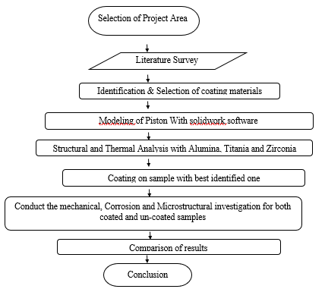
METHODOLOGY

Slide 5
WORKING PRINCIPLE
The high temperature high pollutant exhaust gas is allowed to pass through the belt – mouth assembly of the scrubber in the first phase. The bell – mouth at the inlet/outlet is approximately 2 ½ times more in an area is that of the inlet. This allows the exhaust gas to expand considerably. This expansion allows the gas to cool, because the temperature is a function of pressure. This considerable reduction of backpressure allows for the additional involved due to the introduction of water and lime stone container. The venture effect of the bell – mouth is minimized because the exhaust gas escapes out of the bell – mouth randomly along the periphery.
After expansion, the emission comes in contact with oil; (which could be otherwise being any alkaline solution) where the obnoxious products of combustion are scrubbed when bubbled through it. The bell – mouth also allows for more contact area with water, so that effective cooling takes place with in the short span of time available for the gas to pass through the oil. The length of bubbling can be increased by the oil level in the scrubber tank. But this will be increased result in an abnormal backpressure, which inadvertently affect the performance of the engine. And for this reason the bell – mouth is a multipurpose component, to allow for reduction in back pressure, and provides for an increased contact area with the scrubbing agent.

Slide 6
COATING: AN OVERVIEW COATING TECHNIQUE
Coating is a covering that is applied to an object. The aim of applying coatings is to improve surface properties of a bulk material usually referred to as a substrate. One can improve appearance, adhesion, wetability, corrosion resistance, wear resistance, scratch resistance, etc.
They may be applied as liquids, gases or solids. Coatings can be measured and tested for proper opacity and film thickness by using a Drawdown card.

Slide 7
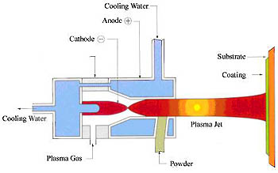
THERMAL SPRAY TECHNIQUE
Thermal spray is a surface treatment process that the subtle and dispersed metal or non-metallic coating material like wire or powder in a melt or semi-molten state, deposits on the substrate surface to form a sort of deposited layer.
Thermal spray material is heated to a plastic or molten state and then accelerated. While these particles hitting the substrate surface, they are deformated due to pressure, form layered sheet, and adhere to the substrate surface. They continuously accumulate and eventually form a layered coating. By changing coating materials, different functions can be realized such as erosion resistance, abrasion resistance, heat insulation, ceramic insulation and so on.

Slide 8
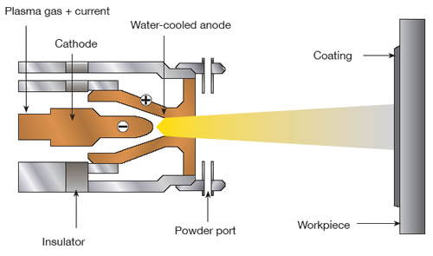
PLASMA COATING PROCESS
In all thermal spray techniques, plasma spray is the most flexible one as it can reach a sufficient temperature to melt or heat any material, so the coating material types are almost unlimited. Plasma spray gun is composed of a small chamber with a cathode (electrode) and an anode (nozzle).
Broken down by high-intensity arc, the gas through the chamber forms plasma substance, and releases large amount of heat, which can reach the temperature of 6000 ℃ ~ 16000 ℃. When the coating material is high-speedily injected into the gas flame, it is melted and impacts on the substrate surface.

Slide 9
COATING POWDER’S : AN OVERVIEW PROPERTIES OF ALUMINA
Aluminium oxide is a chemical compound of aluminium and oxygen with the chemical formula Al2O3. It is the most commonly occurring of several aluminium oxides, and specifically identified as aluminium(III) oxide. It is commonly called alumina, and may also be called aloxide, aloxite, or alundum depending on particular forms or applications. It commonly occurs in its crystallinepolymorphic phase α-Al2O3, in which it comprises the mineral corundum, varieties of which form the precious gemstones ruby andsapphire. Al2O3 is significant in its use to produce aluminium metal, as an abrasive owing to its hardness, and as a refractorymaterial owing to its high melting point
Al2O3 is an electrical insulator but has a relatively high thermal conductivity (30 Wm−1K−1[3]) for a ceramic material. Aluminum oxide is insoluble in water. In its most commonly occurring crystalline form, called corundum or α-aluminium oxide, its hardness makes it suitable for use as an abrasive and as a component in cutting tools.

Slide 10
ZIRCONIA
Zirconia can be found in three crystal structure. These are monolithic (m), tetragonal (t) and cubic (c) structures. Monolithic structure is stable between room temperature and 1170 0C while it turns to tetragonal structure above 1170 0C. Tetragonal structure is stable up to 2379 0C and above this temperature, the structure turns to cubic structure.
Zirconia (ZrO2) is a ceramic material with adequate mechanical properties for manufacturing of medical devices. Zirconia stabilized with Y2O3 has the best properties for these applications.
When a stress occurs on a ZrO2 surface, a crystalline modiﬁcation opposes the propagation of cracks. Compression resistance of ZrO2 is about 2000 MPa. Zirconia is a crystalline dioxide of zirconium. Its mechanical properties are very similar to those of metals and its color is similar to tooth color.

Slide 11
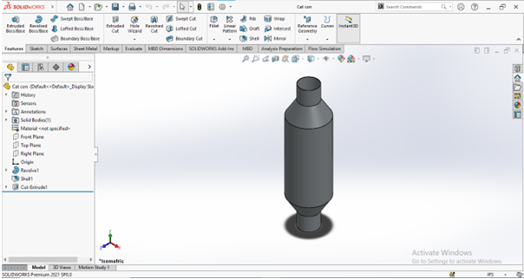
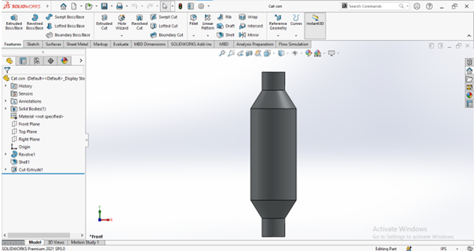
MODELS AND DRAWING Design
Isometric View
Front View

Slide 12
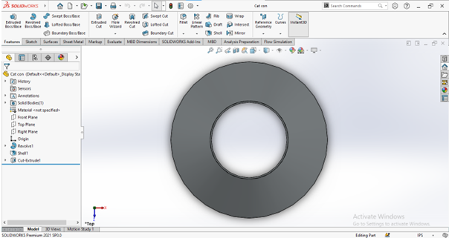
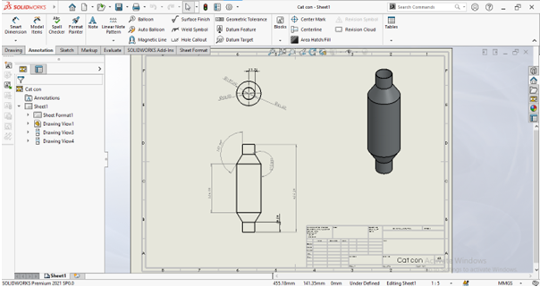
Top View
2D Drawing

Slide 13
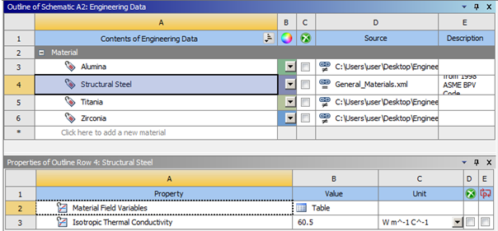
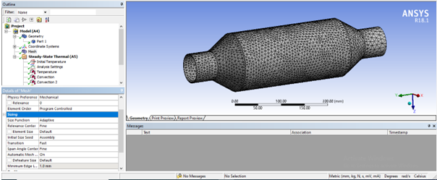
Analysis Analysis Results
Material Property
Mesh

Slide 14
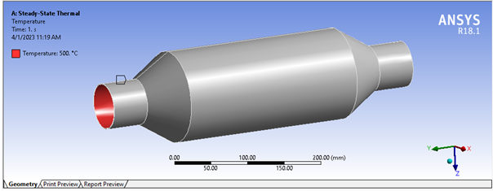
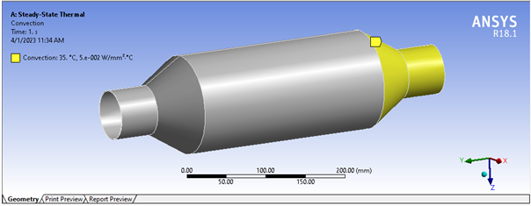
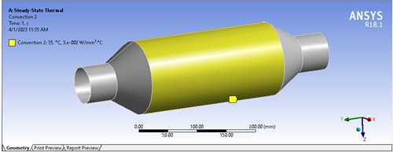
Temperature
Convection 1
Convection 2

Slide 15
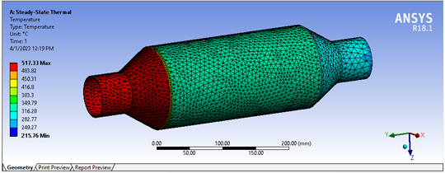
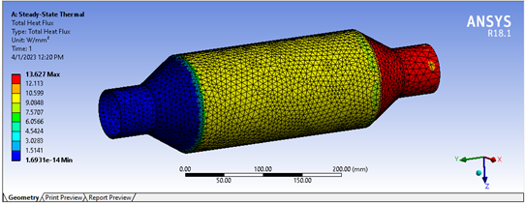
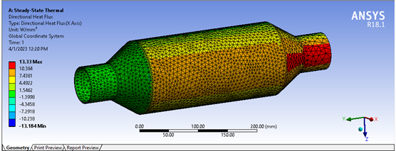
Results
Temperature
Total Heat flux
Directional heat flux

Slide 16
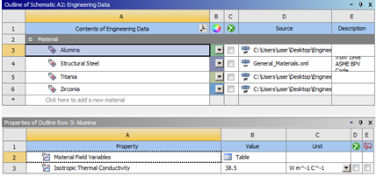
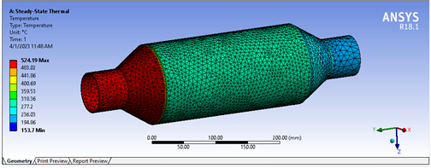
Alumina Coated Results
Material Property
Temperature

Slide 17

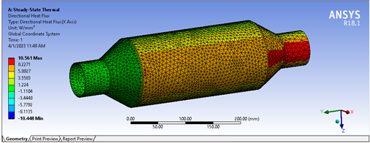
Total Heat flux
Directional Heat flux

Slide 18
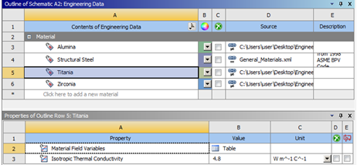
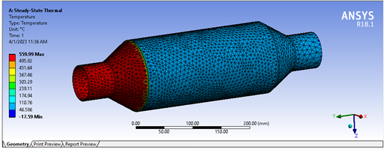
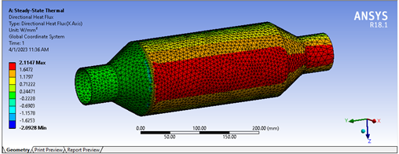
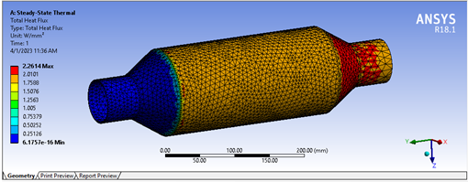
Titania Coated Results
Material Property
Temperature
Total Heat Flux
20 Directional Heat flux

Slide 19
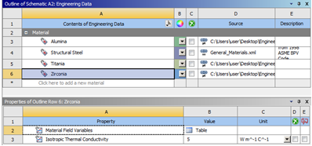
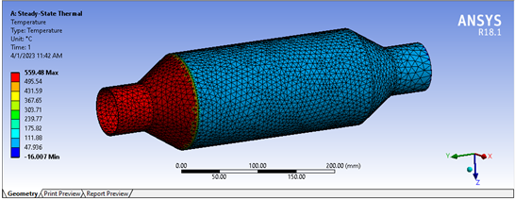

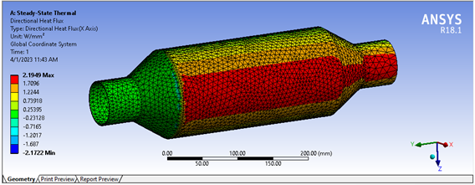
Zirconia Coated Results
Material Property
Temperature
Total Heat flux
Directional Heat flux

Slide 20
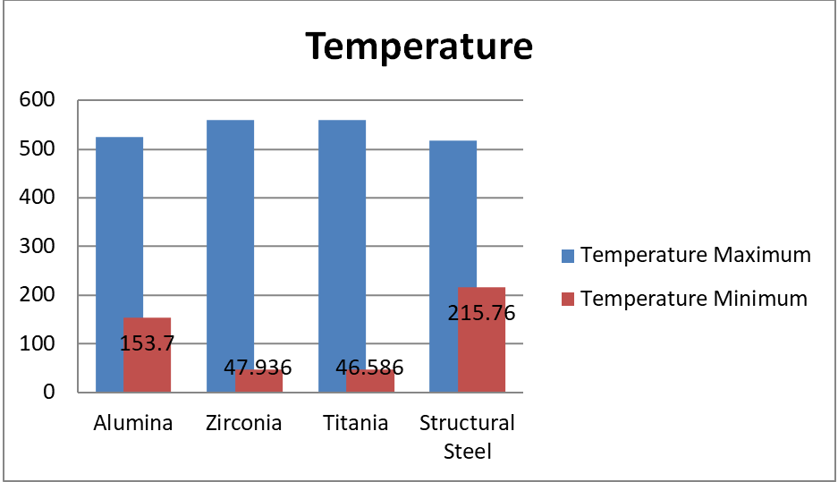
Comparison of analysis
 | Temperature
 | Maximum | Minimum
Alumina | 524.19 | 153.7
Zirconia | 559.48 | 47.936
Titania | 559.99 | 46.586
Structural Steel | 517.33 | 215.76

Slide 21
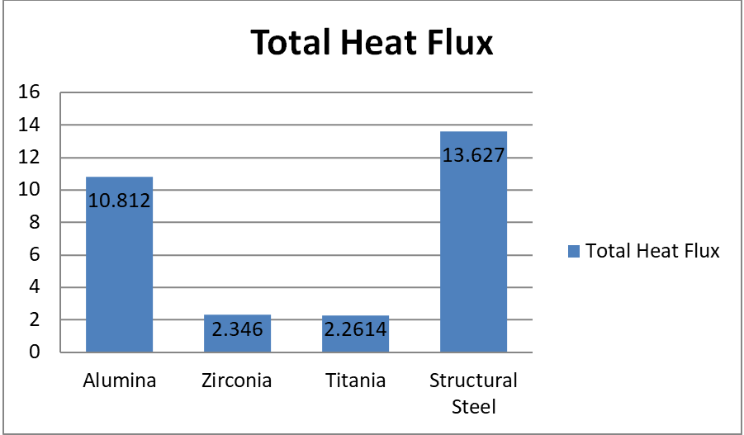
 | Total Heat Flux
Alumina | 10.812
Zirconia | 2.346
Titania | 2.2614
Structural Steel | 13.627

Slide 22
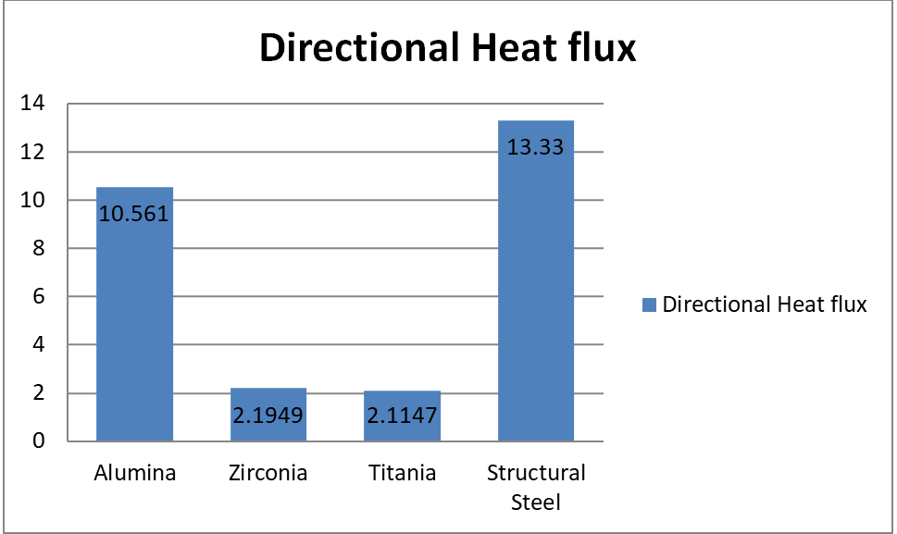
 | Directional Heat flux
Alumina | 10.561
Zirconia | 2.1949
Titania | 2.1147
Structural Steel | 13.33

Slide 23
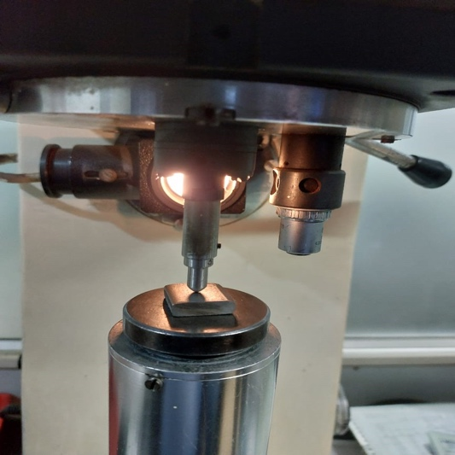
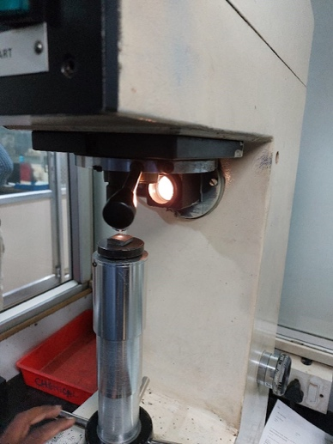
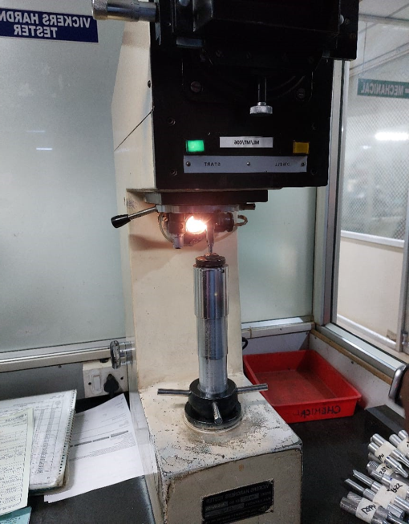
TEST RESULTS

Slide 24
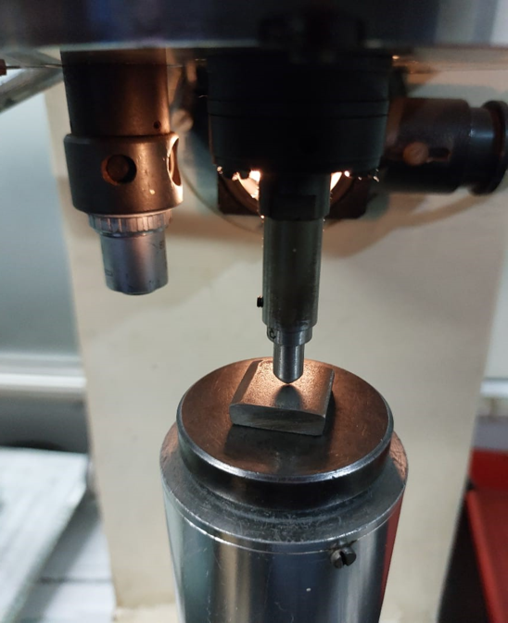
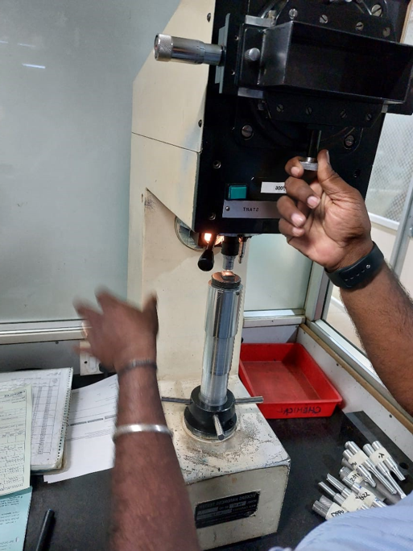
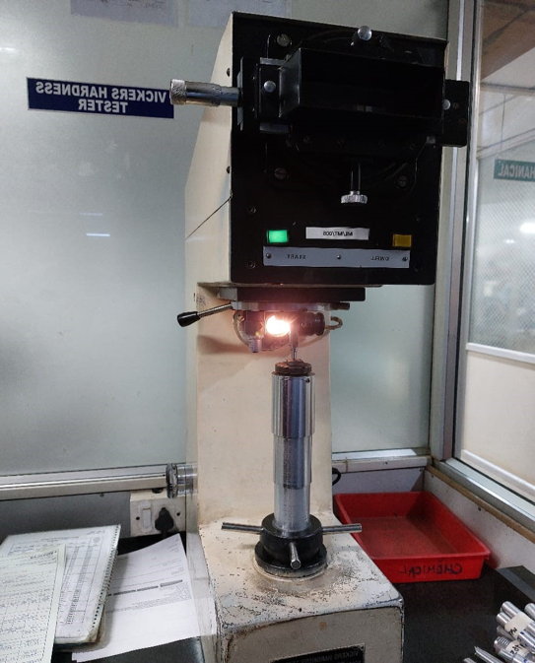

Slide 25
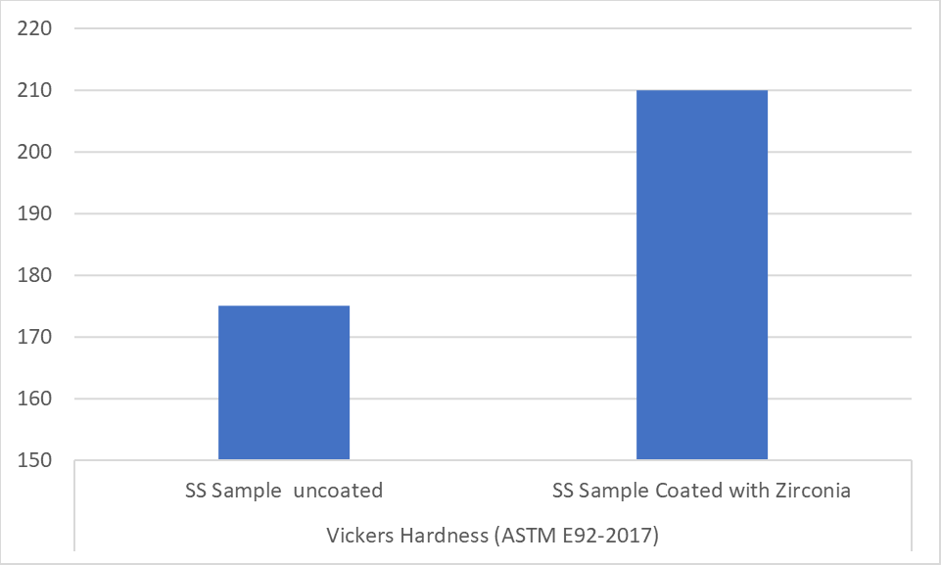
Vickers Hardness Test: (ASTM E92-2017) Table: Vickers hardness test
Test parameters (HV 10kg) | Observed values
Coated | 213, 210, 207
Uncoated | 173,175,177
Vickers Hardness (ASTM E92-2017)
SS Sample uncoated | SS Sample Coated with Titania
175 | 210

Slide 26
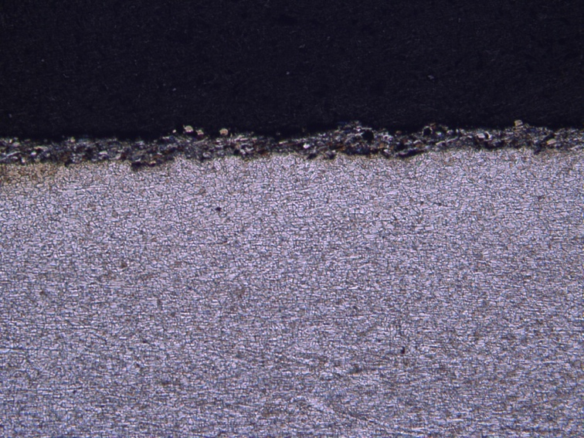
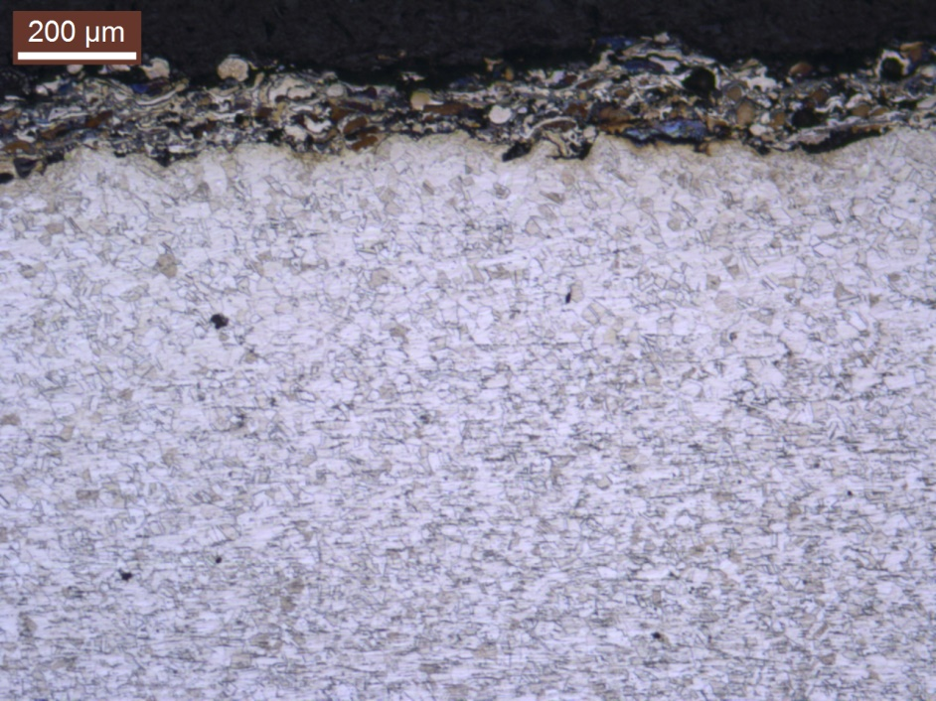
Microstructure Results
Coated Sampe Microstruture results
Bond Coated image

Slide 27
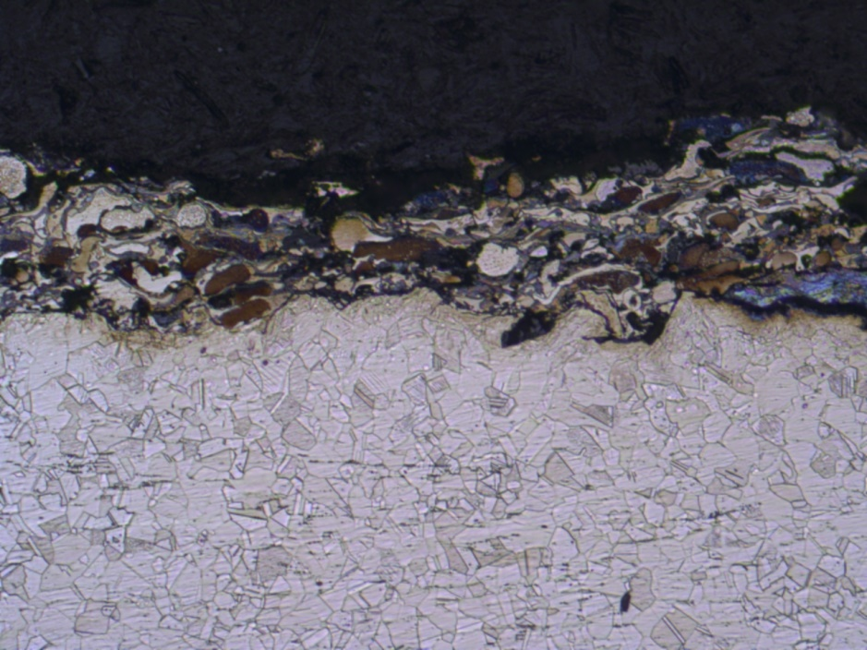
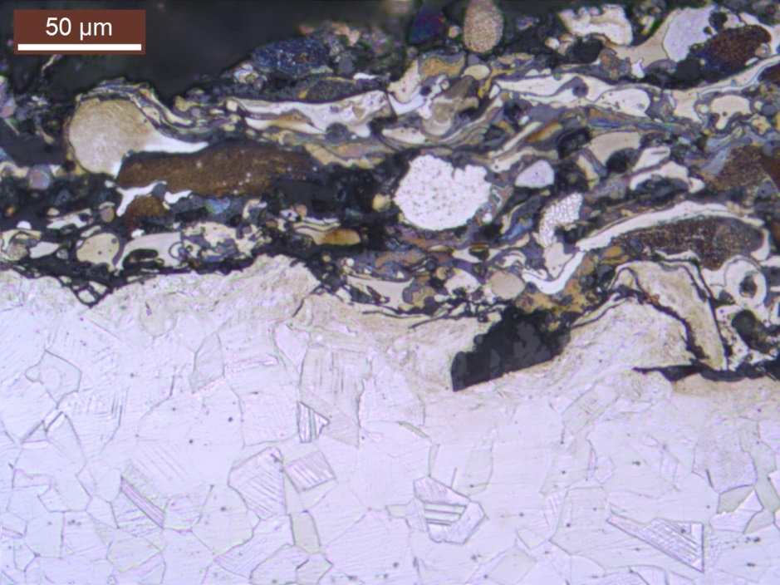
Coated with bond and ceramic coated and un-coated sample
Microstructure results

Slide 28
CONCLUSION
The effectiveness of the catalytic model's conversion is dependent on the temperature of the gas being introduced and the mass flow rates. In comparison to a gas temperature that is lower at the point of entry, a higher temperature at the point of entry results in a greater conversion efficiency across the board. Ceramic coating powders of several types, including alumina, titania, and zirconia, are utilised in the process of designing and analysing the catalytic converters. The use of coated catalytic converters, as opposed to uncoated ones, produced better results in terms of their thermal characteristics, which in turn led to a reduction in emissions. A catalyst that, in order to decrease to harmful gases that pollute the environment, must go through the processes of oxidation and reduction. According to the findings, the thermal nature of the newly developed type of coated catalytic converters makes it possible to manage emissions. In addition, the ceramic coating on the catalytic converter offered a heat barrier, as well as resistance to wear and corrosion. Because of this, the longevity of the catalytic converter was improved.

